Slide 1
Session 1
Basic Concepts of WinForms

Slide 2
Objectives
Explain Class Libraries
Explain the concept of Properties and Methods
Describe event handling concepts
Work with basic interface components

Slide 3
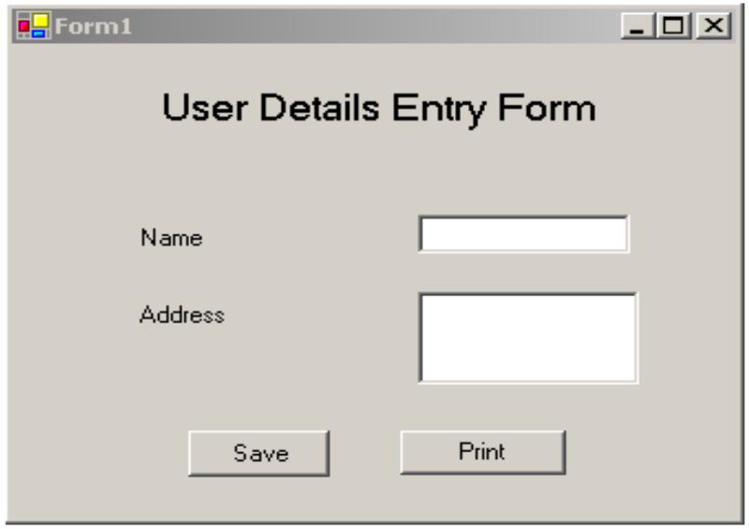
Application
Application
User Interface
Program
private void btnExit_Click(object sender, System.EventArgs e)
{
MessageBox.Show (“Exit clicked”);
}

Slide 4
Introduction to Class Libraries
.NET Framework is based on OO approach
Class library is a collection of reusable classes or types
Class libraries are divided into namespaces
Namespaces group classes according to their common services
Example
System.Windows.Forms

Slide 5


Properties and Methods
Class
Frog
Object
Instance of Object
Height
Weight
Name
Height :12 cm
Weight :100gm
Name : Jumpie
properties
method
Jump

Slide 6
Events and Event Handlers
EVENT HANDLING
Events
Event handlers
Event driven programming

Slide 7

Event Handling Example
event
Event Handler
Click
Code written in
C#,VB.NET

Slide 8
User Interfaces
Features of good user interfaces
Easy to learn
Easy to use
Attractive
Type of user interfaces
Character based
GUI based

Slide 9
Windows Application
The basic unit is a form
Uses of a Form ???
Presents information to the user
Receives information from the user
An application can have multiple forms

Slide 10
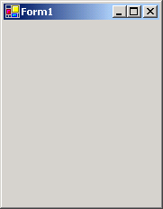
Winforms GUI
Form is represented as a class in Winforms
Whenever an application is created, a form is
added
Properties, methods and events are classified
as shared and instance types
Form

Slide 11
Winforms GUI Contd…
Shared properties deal with multiple instances of the same class
Instance properties are assigned for each instance of the class
Example
WindowsApplication1.Form1.Enabled=True;
CustomerForm.Enabled=True;

Slide 12
Form Properties, Method and Events
Shared Properties | Instance Properties: Appearance Properties
ActiveForm | Text, BackColor, ForeColor, Font
Instance Methods | Instance Properties: Behavior Properties
Activate, Close | Enabled
Events | Instance Properties: Layout Properties
Activated, Closed, Closing, Deactivate, Load | MaximumSize, MinimumSize, Size

Slide 13
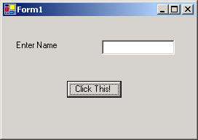
Controls
Form object has many Visual Interface Components
Visual Interface Components are collectively known as Controls
Controls

Slide 14
Some Common Properties of Controls
Properties
BackColor
CanFocus
Enabled
ForeColor
Name
Text
Visible

Slide 15
this keyword
Represents the current active form
All properties, methods, events of the form can be accessed
Example
this.[controlname].[propertyname]

Slide 16
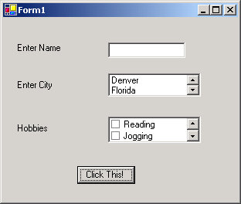
Different Controls
Label
TextBox
Button
ListBox, CheckedListBox
ComboBox

Slide 17
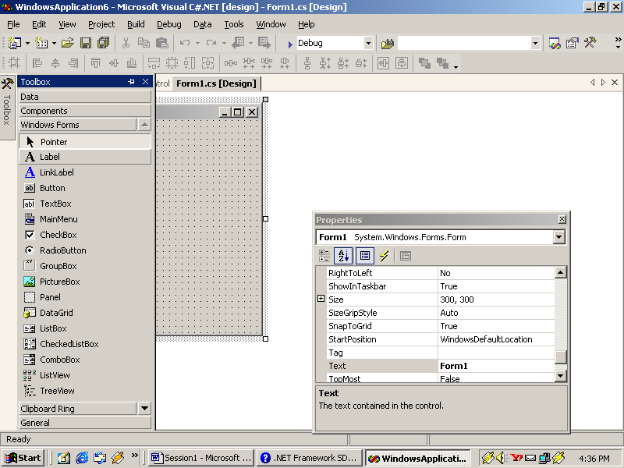
Label
Label
Properties
Methods
Image
Hide
Events
Show
TabIndex
Paint

Slide 18
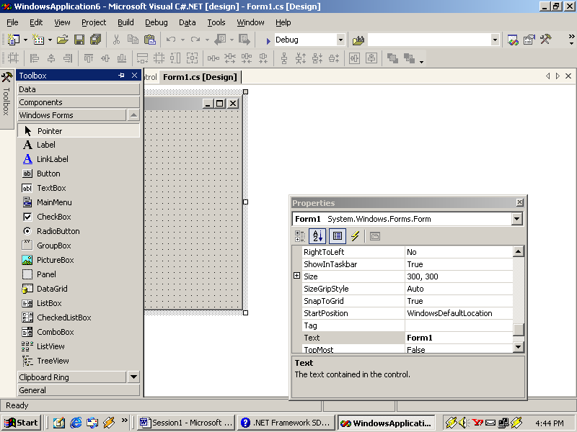
TextBox
Properties
Methods
TextBox
AcceptsReturn
AppendText
ReadOnly
Clear
PasswordChar
Paste
Events
MaxLength
Cut
TextChanged
Multiline
Copy
MultilineChanged
ScrollBars

Slide 19
Button
Button
Properties
Methods
PerformClick
DialogResult
Events
TextAlign
Click

Slide 20
ListBox
ListBox
Items
SelectedItems
MultiColumn
Sorted
Properties
SelectedIndex
SelectedValue
SelectedItem
Text

Slide 21
ListBox Contd…
Listbox
Methods
Events
ClearSelected
SelectedIndexChanged
GetSelected
SelectedValueChanged
FindString
SetSelected

Slide 22
CheckedListBox
CheckedListBox
Properties
Methods
ThreeDCheckBoxes
GetItemChecked
CheckedItems
Events
GetItemCheckState
ItemCheck
SetItemChecked
CheckedIndices
SetItemCheckedState

Slide 23
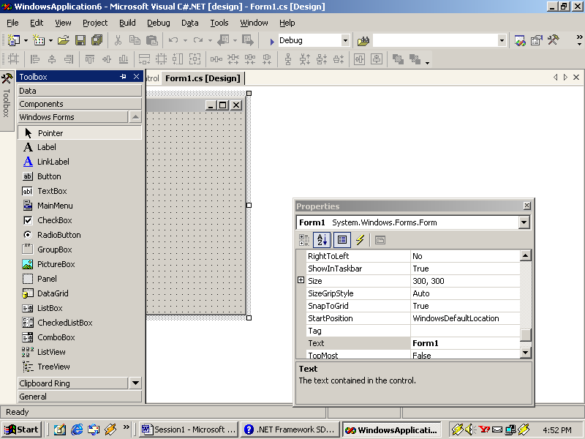
ComboBox
ComboBox
Properties
Methods
MaxDropDownItems
Select
Events
DropDownStyle
SelectAll
DropDown
Focused

Slide 24
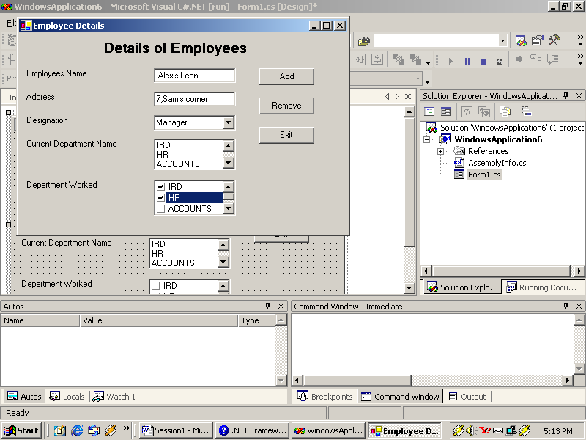
Some Form Components
Identify the controls on this form

Slide 25
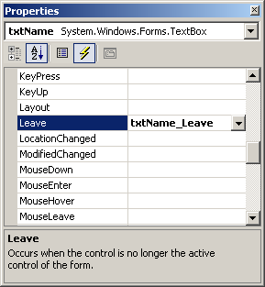
Event List in the Properties Window

Slide 26
Summary
Class libraries are the collection of reusable classes, or types.
Classes are the basis of all objects.
A class contains the characteristics and functionality that objects can possess. The characteristics and functionality are known as Properties and Methods respectively.
An Object is an instance of a class, which can be used to access the properties and methods defined in the class.
An Event is any action directed at the application.
The set of code that is executed in response to an event is called the Event Handler.
The capturing of events and execution of the event handler is called Event Handling.
All interactions between the user and the application take place through the user interface. A good user interface should be:
  Easy to learn
  Easy to use
  Attractive

Slide 27
Summary Contd…
User interfaces can be of any of the following two types:
  Character Based Systems
  Graphical User Interface
The basic unit of the Windows applications created in WinForms is a Form.
The form objects can contain certain visual interface components that can be used for the interactions between the user and the application. The Visual interface components are collectively known as Controls.
The ‘this’ keyword represents the currently active form in the C# language.
The Label control is used to display text that cannot be edited by the user.
The TextBox control is used to accept input from the user or display text to the user.
An easy way to allow the user to interact with an application is by using the Button control.
The ListBox control is used to display long lists of options from which the user can choose.
The ComboBox control combines the features of the TextBox and the ListBox controls.

